Slide 1
E WEB Creators
PHASE 1
CSP-584
Enterprise Web Applications
Parth Patel A20405581
Krunal Sevak A20405875
Pradyot Mayank A20405826

Slide 2
Creating website for your local business is so easy!
Submit Requirements
Wait For Approval & Get Quote
Get Live Project Status
Make Payment
Ready to Deploy!

Slide 3
About the System
It is well known fact that software companies undertake huge projects more than one at a time. Hence there is a profound need for the organizations to manage all the projects efficiently and ensure that projects cycle goes on smoothly and they are completed on time.
E Web-Creators deals with the various levels of project development and will account for time used in phases vise analysis, design, coding, testing and implementation etc.
DESCRIPTION:
E Web-Creators gives the management clear picture of usage of time by projects. By analyzing the results provided by the software they might rectify the defects in utilizing time and take remedial actions.
E Web-Creators takes Task & Project Status reports as input.
E Web-Creators gives the individual report of the project, which contains time used for various tasks.
This project deals with Four modules – Admin, Client, Human Resource Manager (HR) and Project Manager (PM).

Slide 4
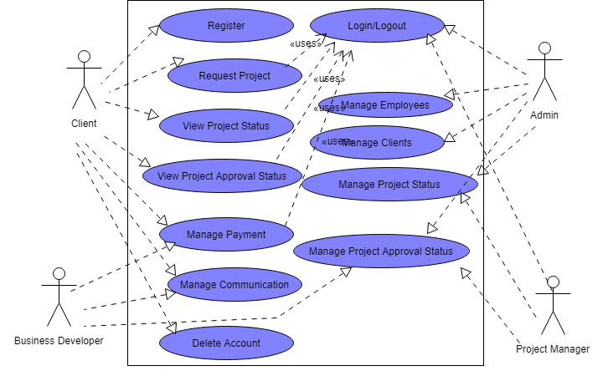
USE CASE DIAGRAM

Slide 5

HOME PAGE

Slide 6
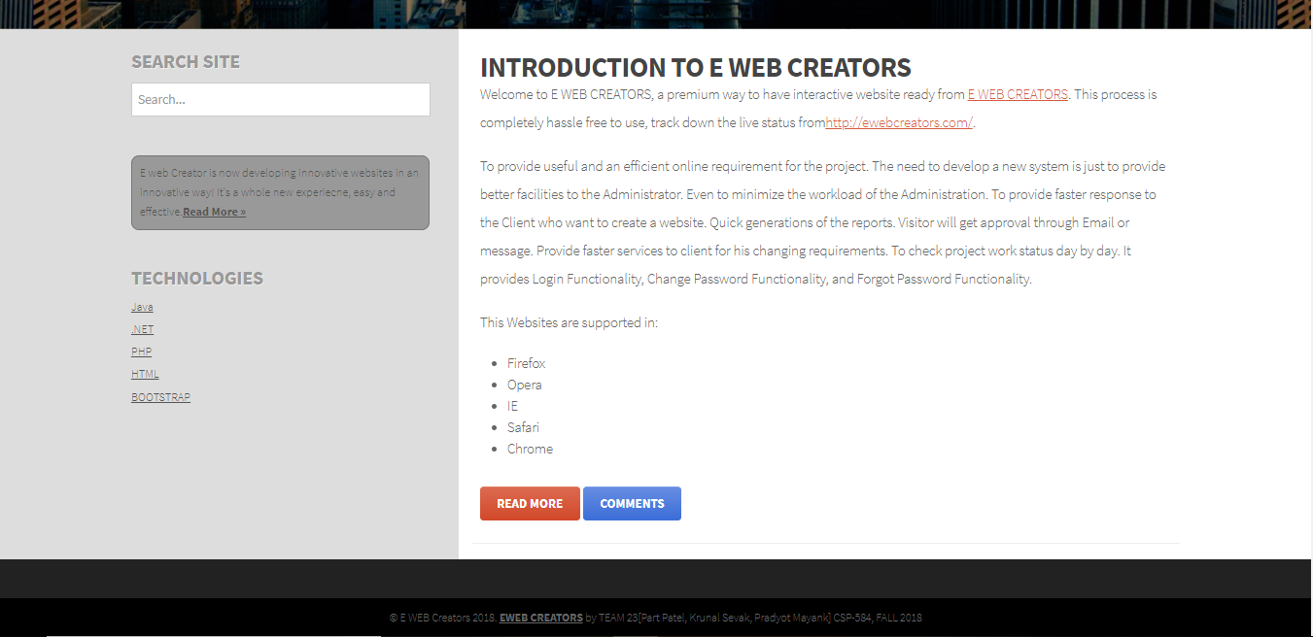
HOME PAGE

Slide 7
THANK YOU!
Template Reference:
https://justfreetemplates.com/web-templates/view/3333.html

